Slide 1
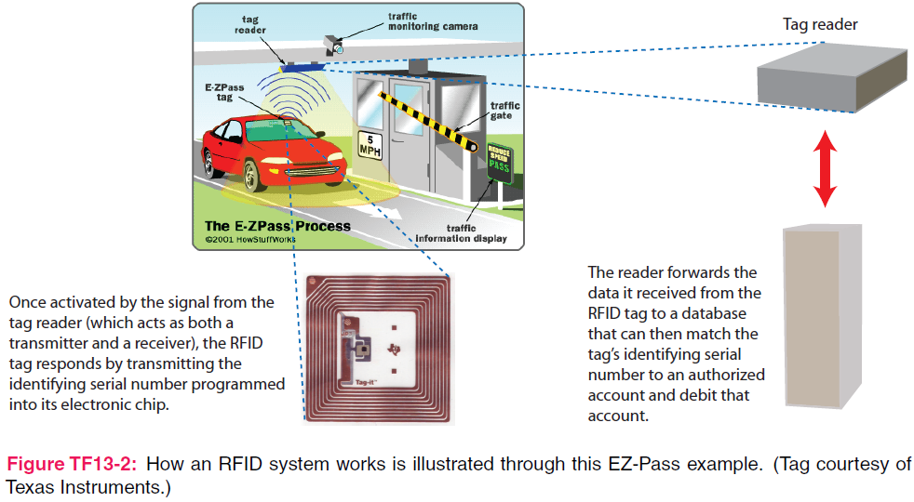
7. Plane Wave Propagation
Applied EM by Ulaby, Michielssen and Ravaioli

Slide 2
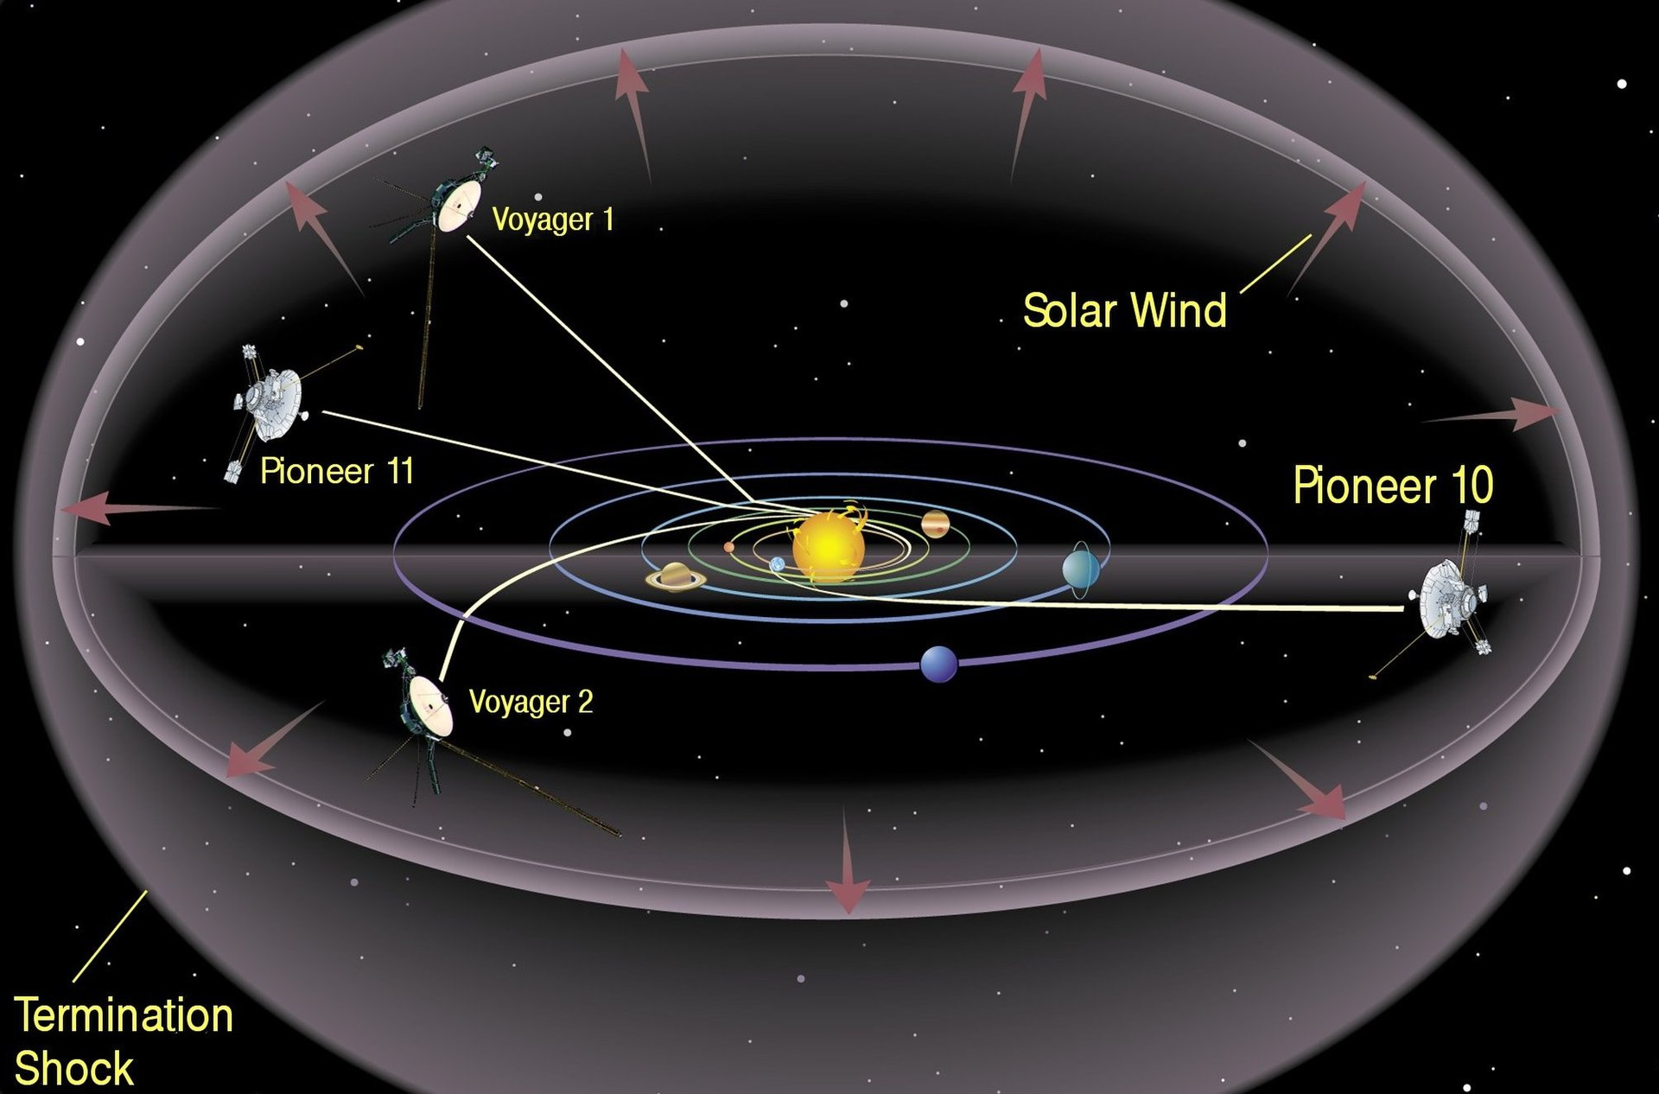
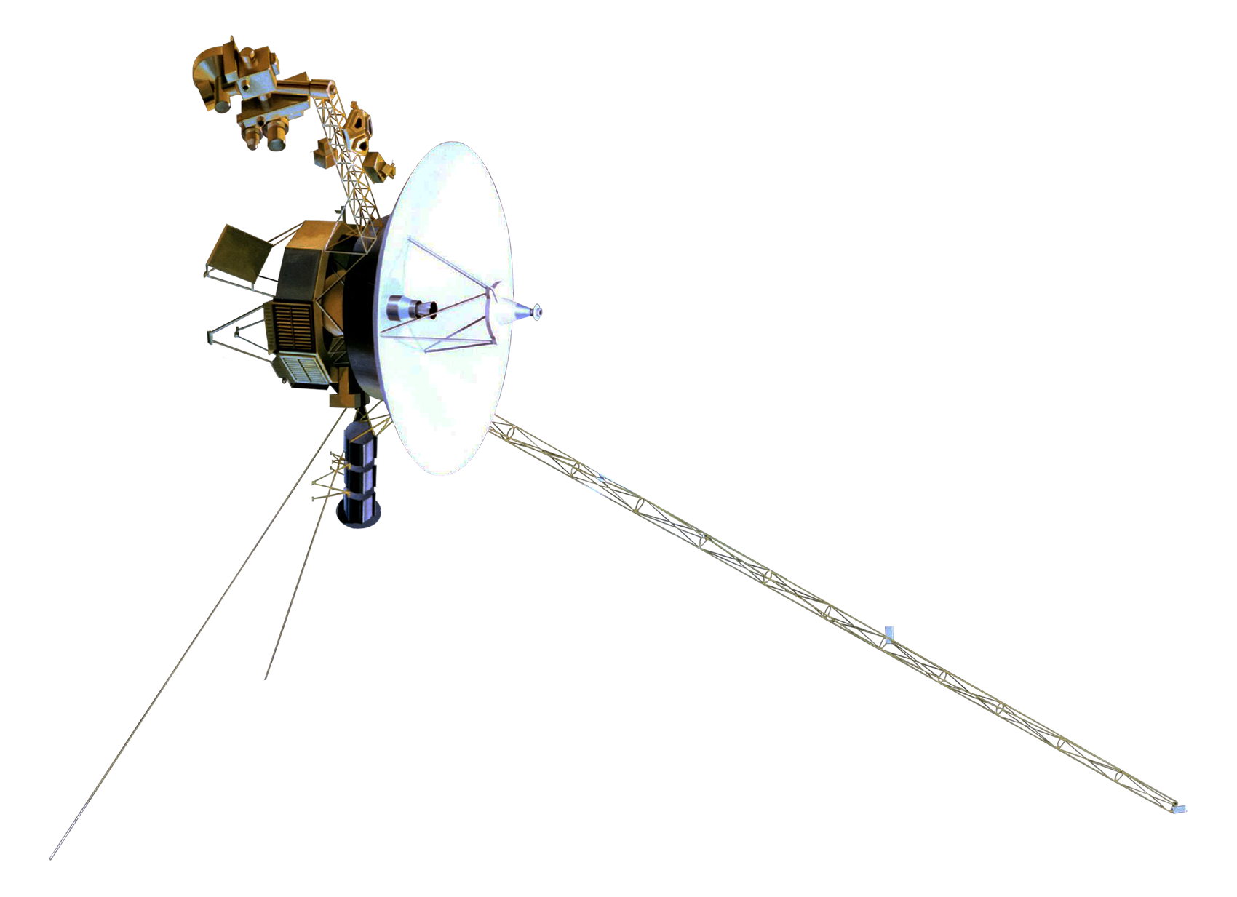
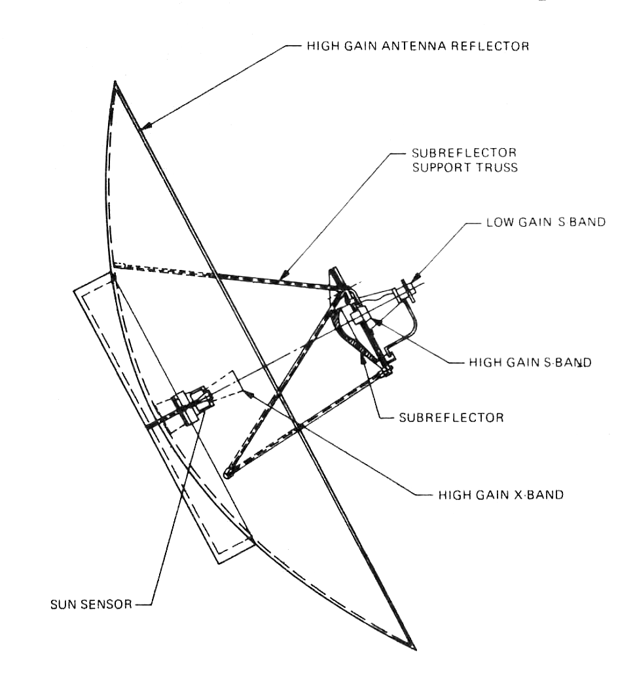
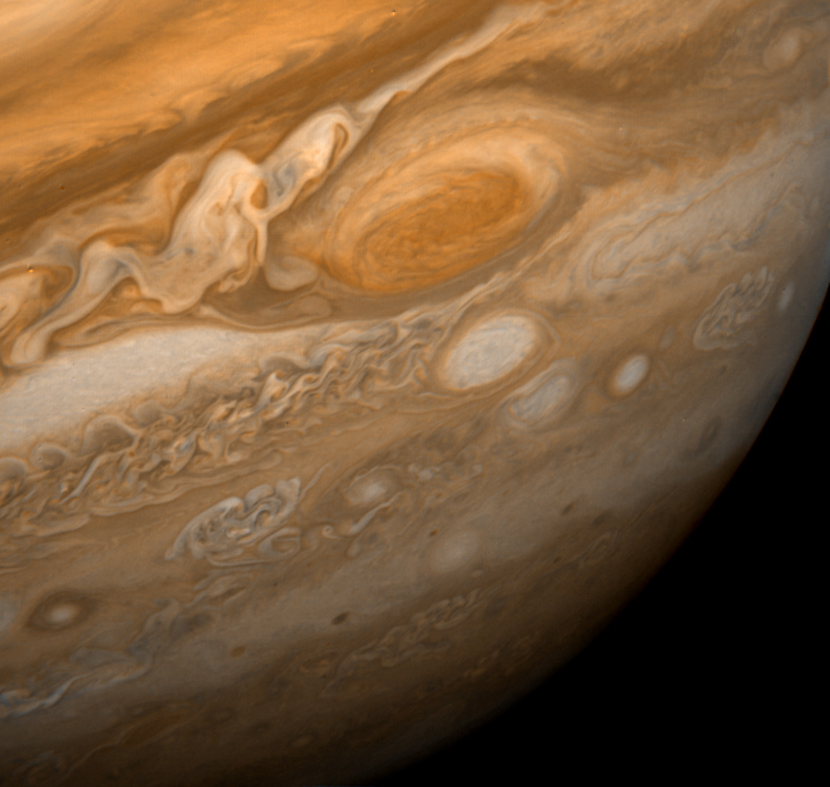
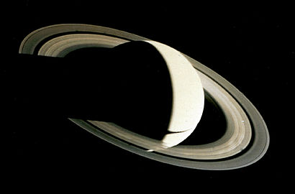
Communication to Voyager 1
The radio communication system of Voyager 1 was designed to be used up to and beyond the limits of the Solar System. The communication system includes a 3.7-meter (12 ft) diameter high gain Cassegrain antenna to send and receive radio waves via the three Deep Space Network stations on the Earth.^{[21]} The craft normally transmits data to Earth over Deep Space Network Channel 18, using a frequency of either 2.3 GHz or 8.4 GHz, while signals from Earth to Voyager are transmitted at 2.1 GHz.^{[22]}
When Voyager 1 is unable to communicate directly with the Earth, its digital tape recorder (DTR) can record about 67 megabytes of data for transmission at another time.^{[23]} Signals from Voyager 1 take over 21 hours to reach Earth.^{[3]}

Slide 3
Chapter 7 Overview
Maxwell Equations
Wave Equations
Uniform Plane Waves (UPW)
Wave Polarizations
Lossy Media
AC Current and Resistance
Power Density

Slide 4
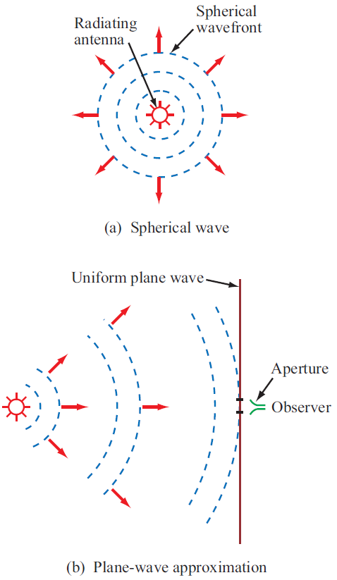
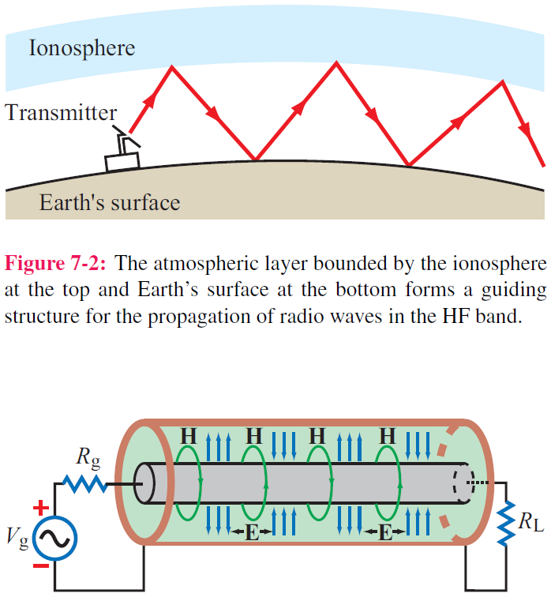

Guided EM Waves
Unbounded EM Waves

Slide 5
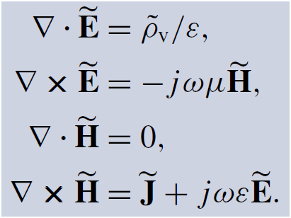
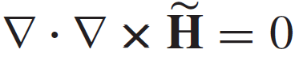
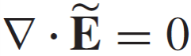
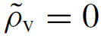
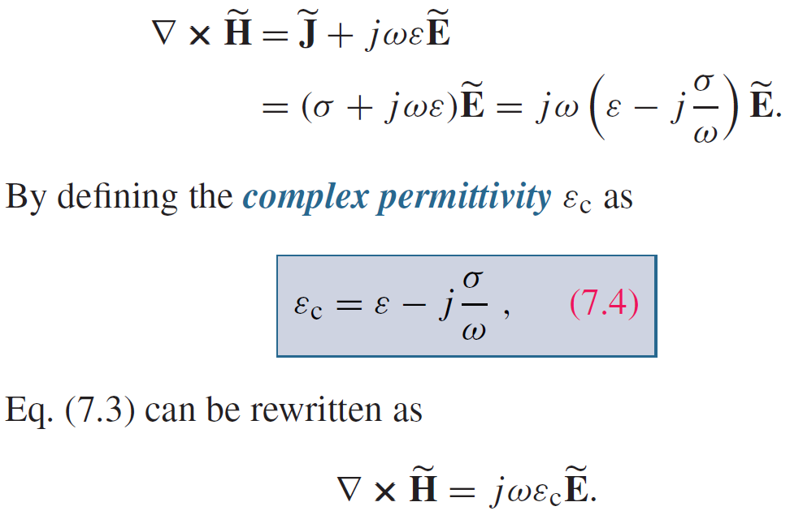
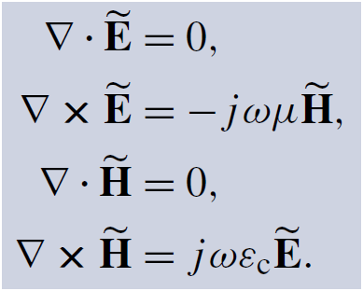
Maxwell’s Equations
For sinusoidal time variations:
For any vector field:
Hence:
and
Consequently, Maxwell’s equations become:
We will use these to derive the wave equation for EM waves.

Slide 6
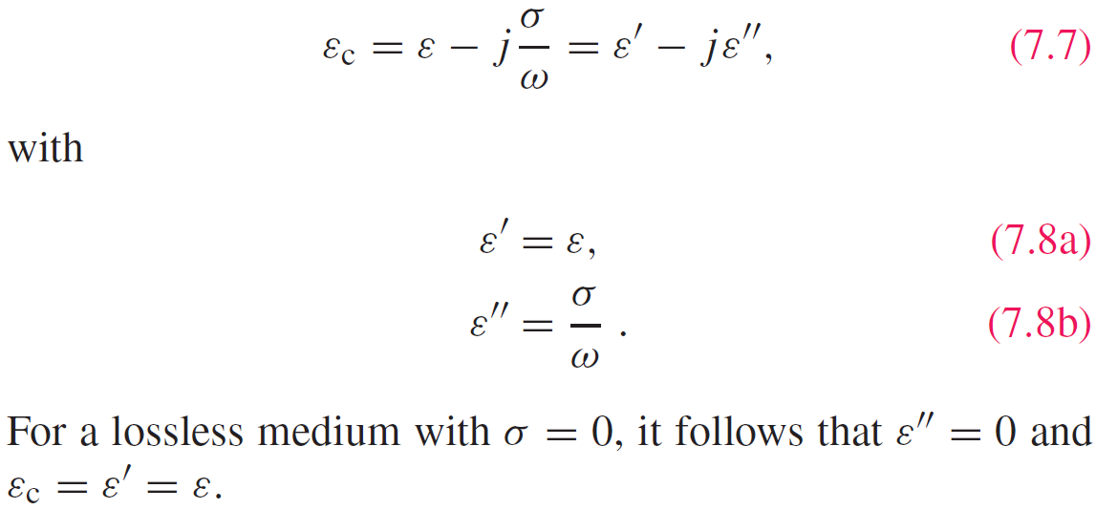
Complex Permittivity

Slide 7
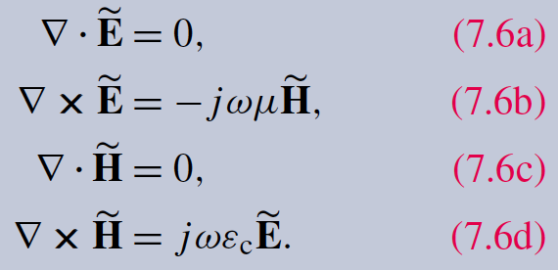
Wave Equations

Slide 8
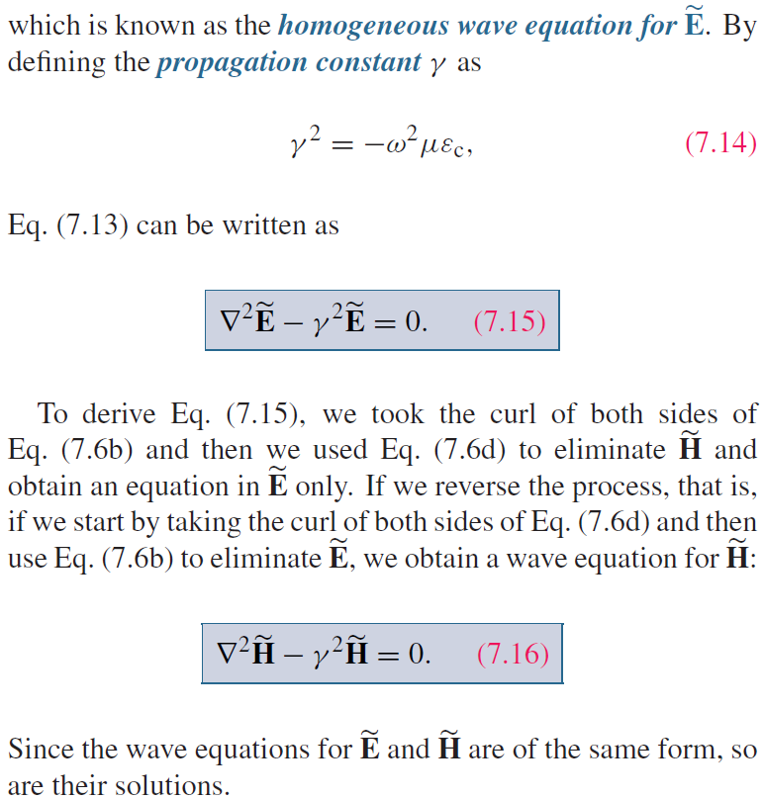
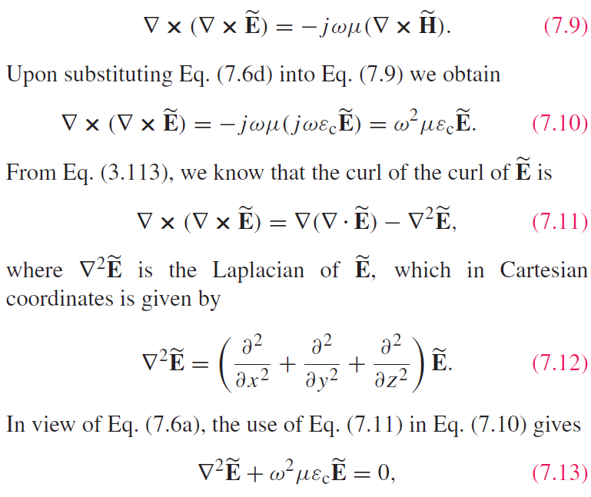
Wave Equations

Slide 9
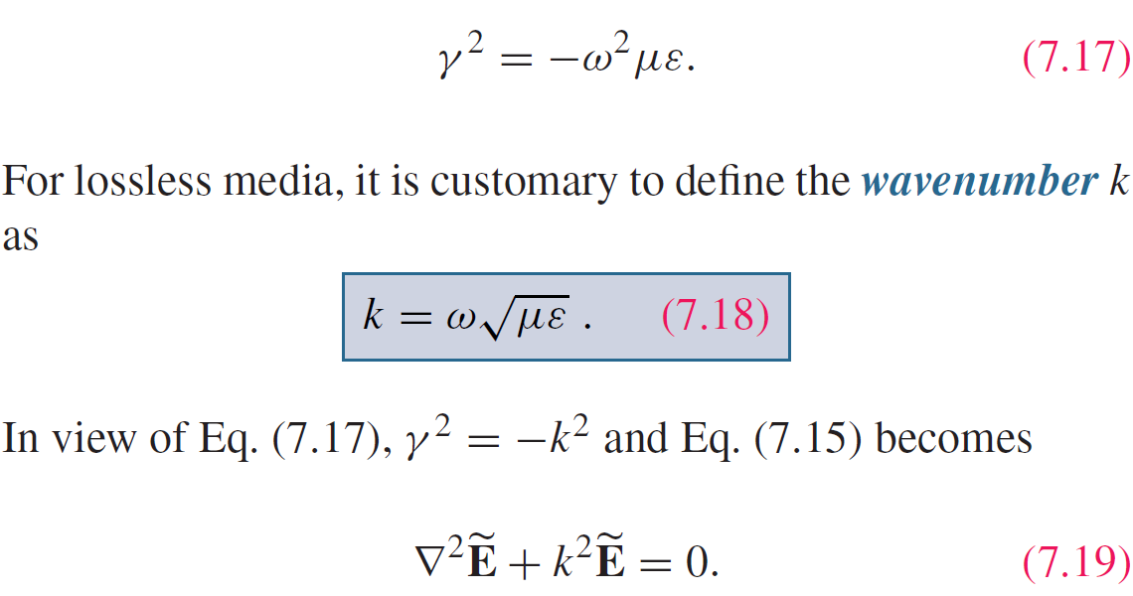
Lossless Media
If the medium is nonconducting (σ = 0), the wave does not suffer any attenuation as it travels and hence the medium is said to be lossless.

Slide 10
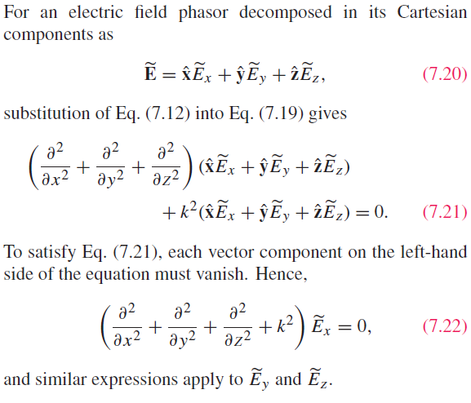
Uniform Plane Wave
Cont.

Slide 11
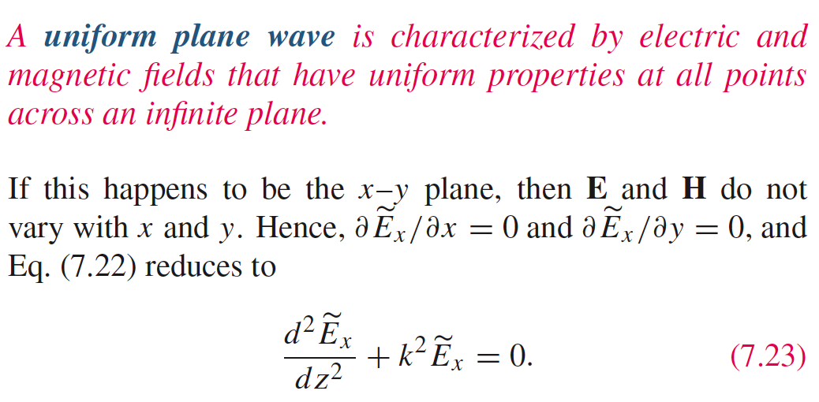
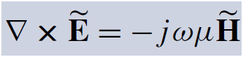
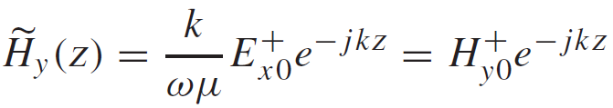
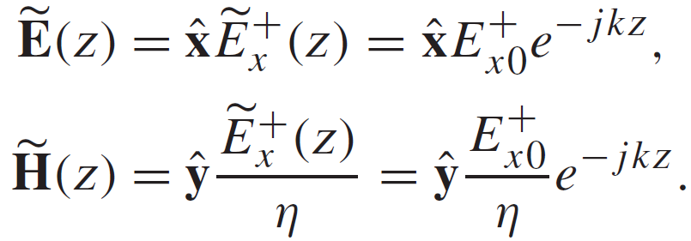
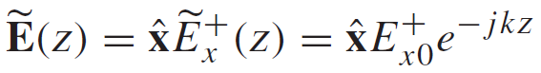
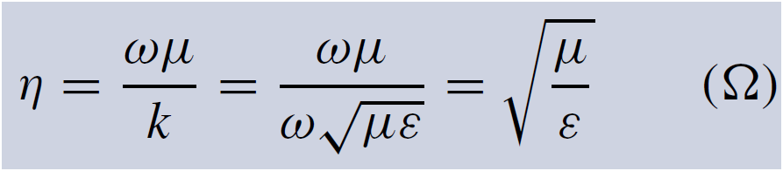
Uniform Plane Wave
Application of
yields:
General Form of the Solution:
Summary: This is a plane wave with
For a wave travelling along +z only:
with

Slide 12
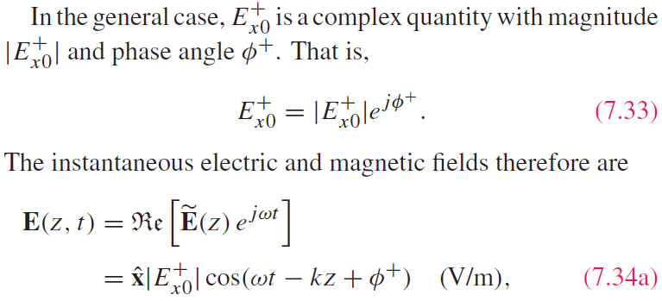
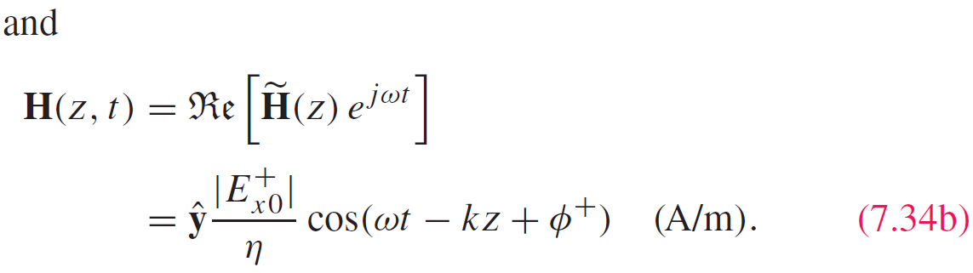
Summary from previous slide:
Time-Domain Solution

Slide 13
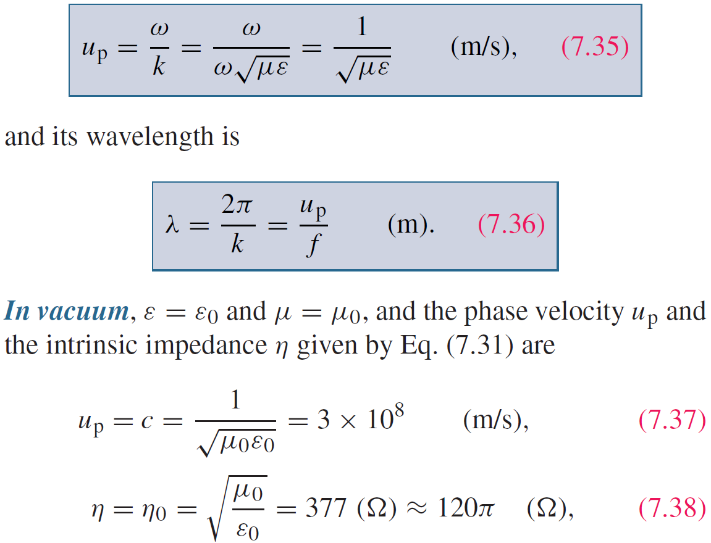
Wave’s Phase Velocity

Slide 14
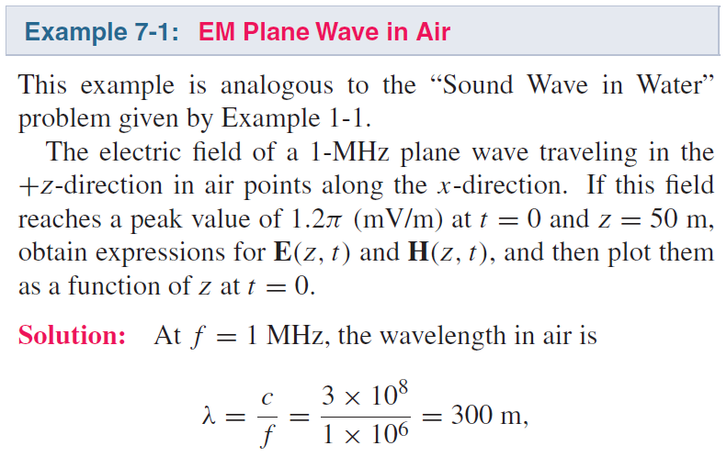
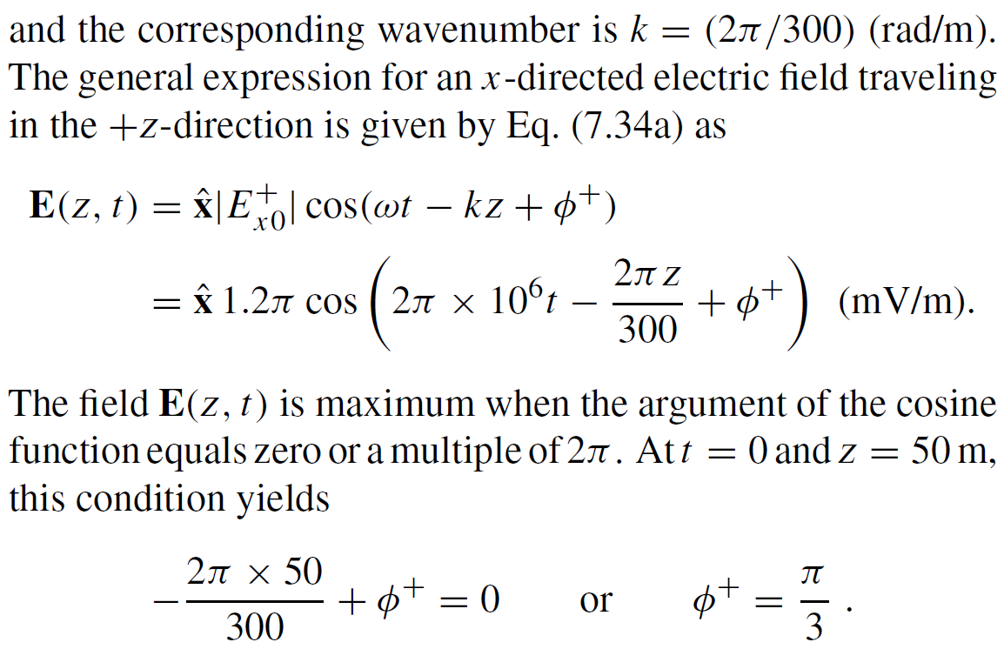
Cont.

Slide 15
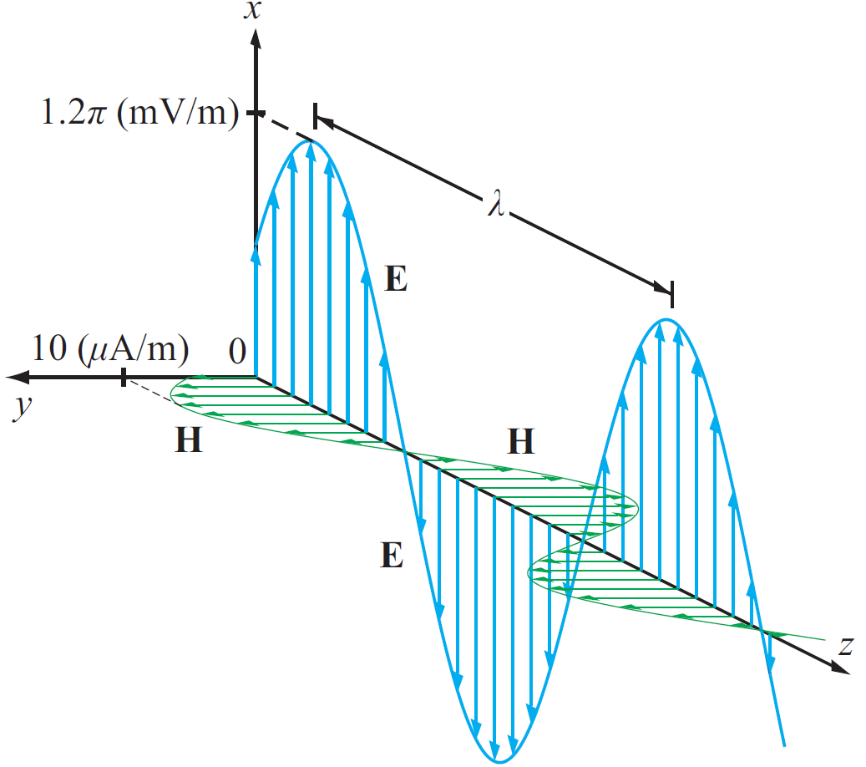
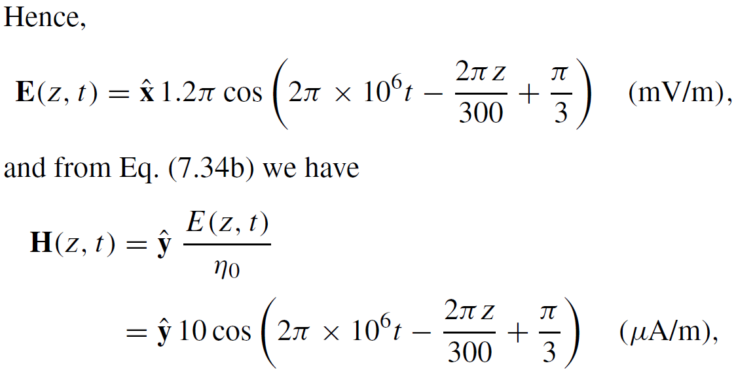
Example 7-1 cont.

Slide 16
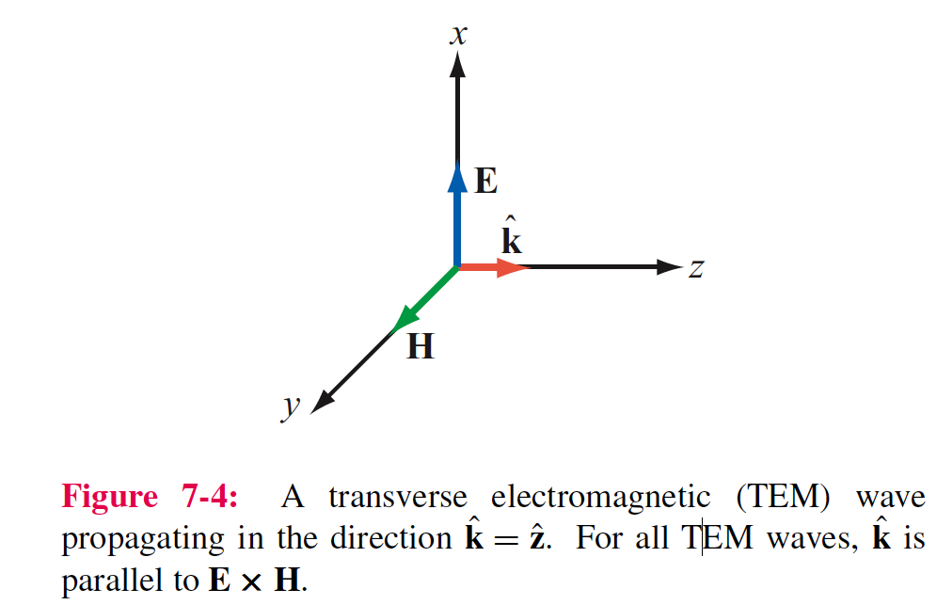
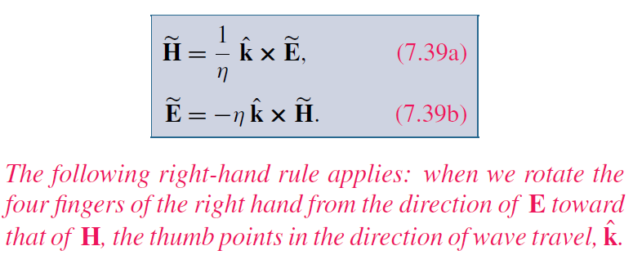
Directional Relation Between E and H
For Any TEM Wave

Slide 17
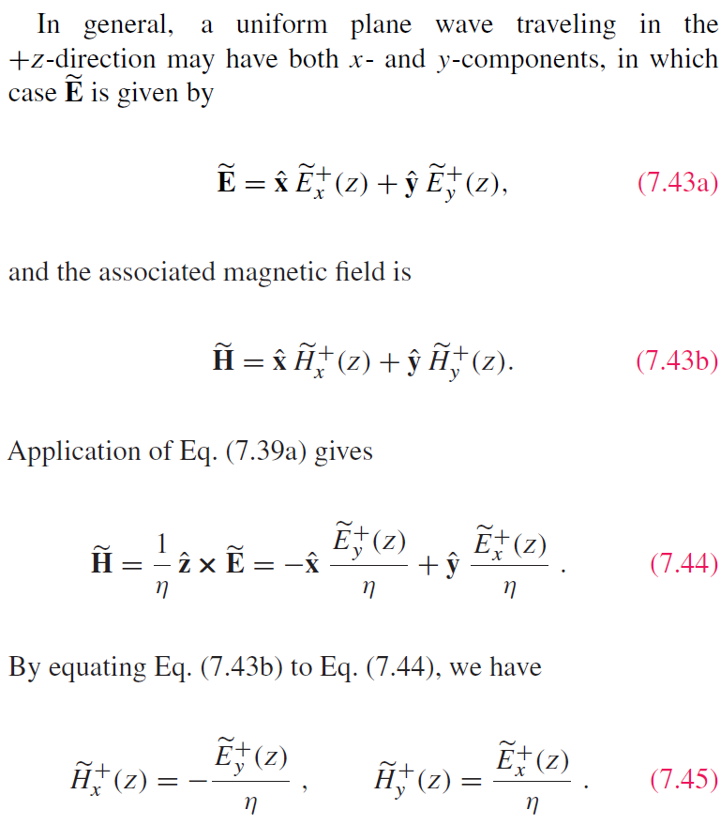
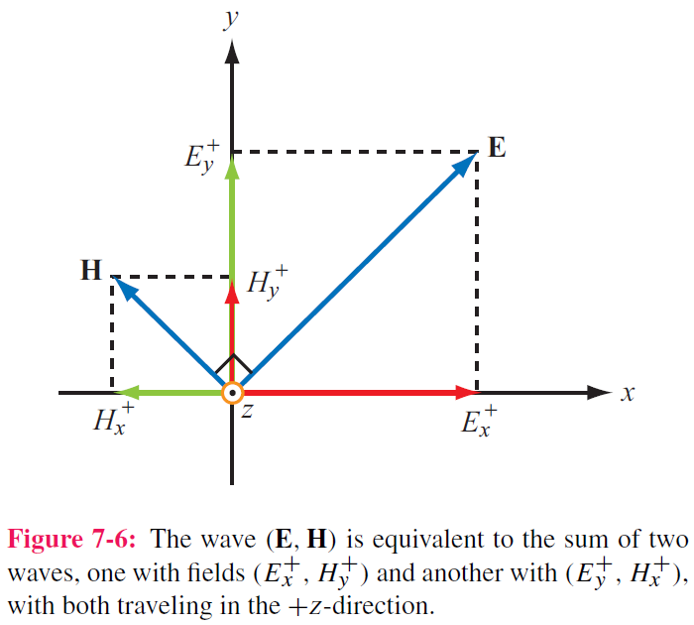
Wave decomposition

Slide 18
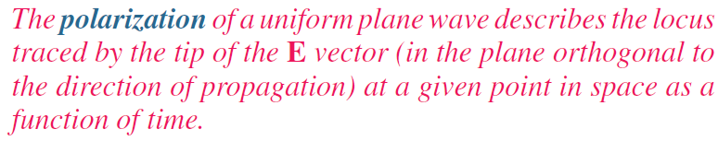
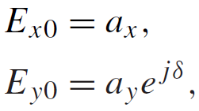
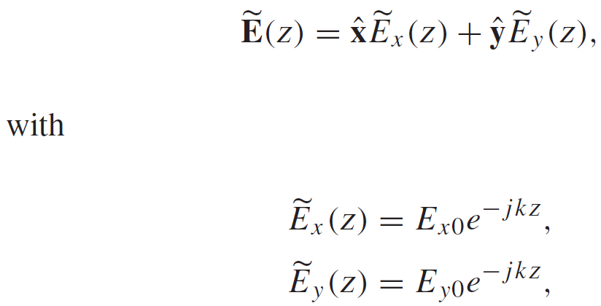
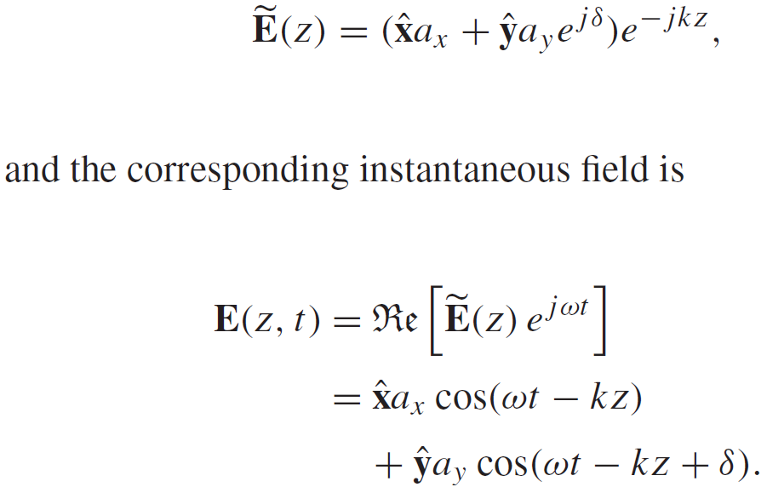
Wave Polarization
If:
Plane wave propagating along +z :
then

Slide 19
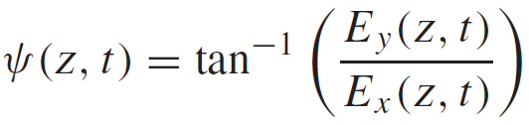
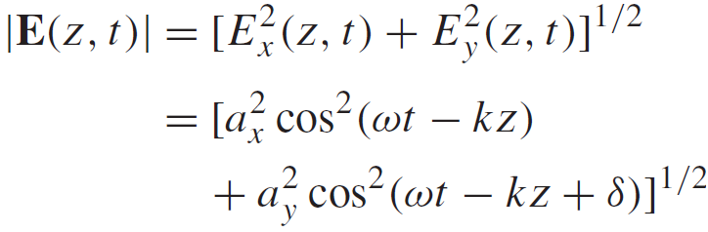
Polarization State
Polarization state describes the trace of E as a function of time
at a fixed z
Magnitude of E
Inclination Angle

Slide 20
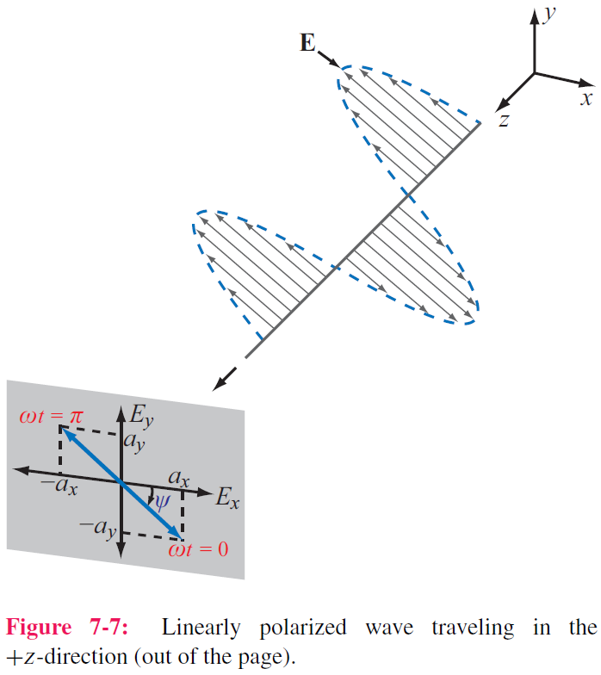
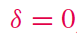
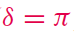
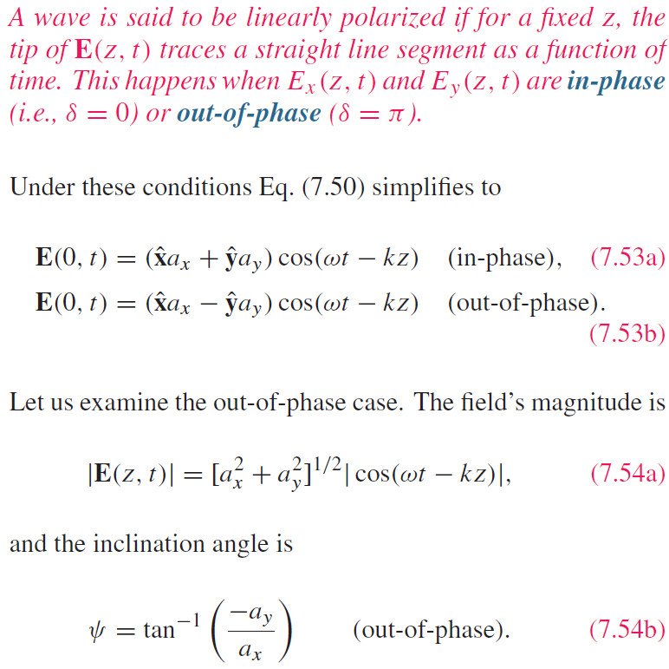
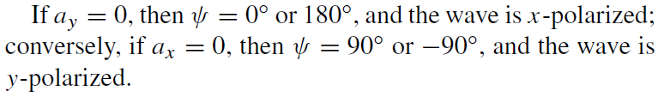
Linear Polarization:
or
E traces a line( in blue) as the wave traverses a fixed plane

Slide 21
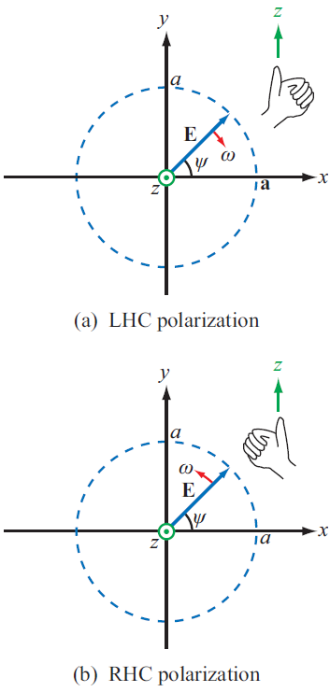
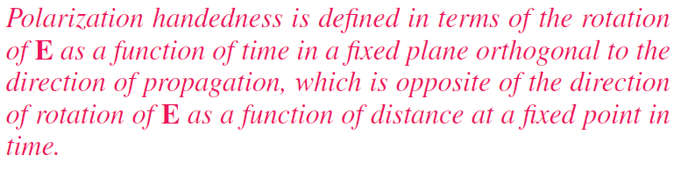
Polarization Handedness
https://en.wikipedia.org/wiki/Circular_polarization

Slide 22





LH Circular Polarization:

Slide 23


RH Circular Polarization:

Slide 24



Cont.

Slide 25


Example 7-2 cont.
Wave with electric field magnitude
of 3 (mV/m) traveling in the +y-direction
Cont.

Slide 26



Example 7-2 cont.

Slide 27




Elliptical Polarization: General Case
Linear and circular polarizations are special cases of elliptical

Slide 28


Lossy Media
Cont.

Slide 29

Lossy Media

Slide 30

Attenuation
E and H fields:
Cont.

Slide 31


Attenuation
Magnitude of E
Skin depth

Slide 32

Low and High Frequency Approximations

Slide 33

Example 7-4: Plane Wave in Seawater
Cont.

Slide 34

Example 7-4: Plane Wave in Seawater
Cont.

Slide 35

Example 7-4: Plane Wave in Seawater
Cont.

Slide 36

Example 7-4: Plane Wave in Seawater
Cont.

Slide 37

Example 7-4: Plane Wave in Seawater

Slide 38

dc vs ac Current Flow in Conductors

Slide 39



Linear Conductor
For a conductor with E₀ at the surface:
Total current crossing y-z plane:

Slide 40

Surface Impedance
Thus, conductor is equivalent to a resistor in series with an inductor.

Slide 41


ac Resistance of Coaxial Cable
Since in the ac case, most of the current flows through a very thin skin along the outside of the inner conductor and along the inside of the outer conductor, we can use the results of the planar conductor to figure out the resistance of the coax. The procedure leads to the following expression for the resistance per unit length:

Slide 42




Power Density
Poynting vector:
Total power intercepted by A:
Time-average power density:

Slide 43


Power Density Carried by Plane Wave
For a plane wave with E field :
the average power density carried by the wave is:

Slide 44





Plane Wave in Lossy Medium
For a plane wave travelling in a lossy medium:
the power density is :

Slide 45




Slide 46
Equations in Plane Waves
Wave polarizations
Poynting vector:
Time-average power density:

Slide 47
Equations in Plane Waves

